Slide 1


Slide 2



Slide 3
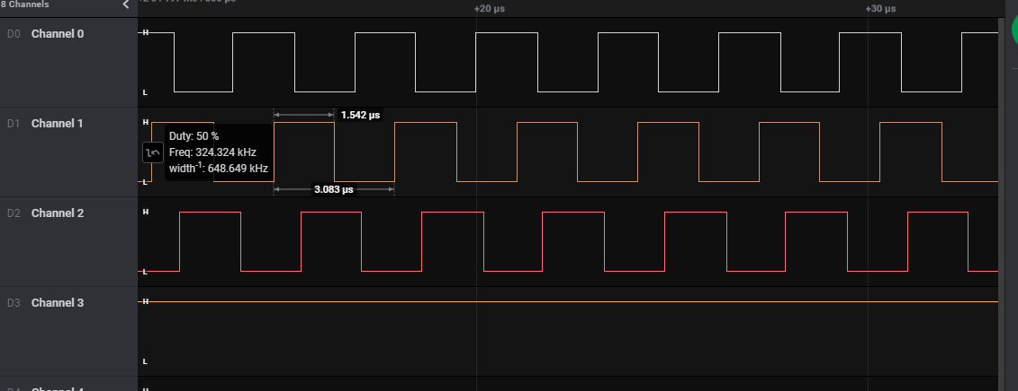
3 group
Group 0 -2 channel
Group1 – 1 channel
Group2 – 1 Channel

Slide 4
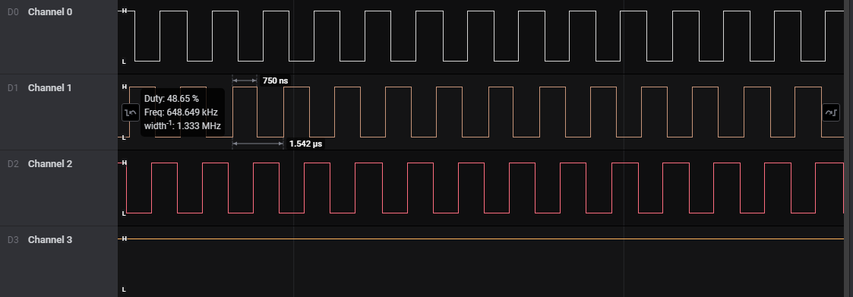
3 Groups Single channel

